Slide 1
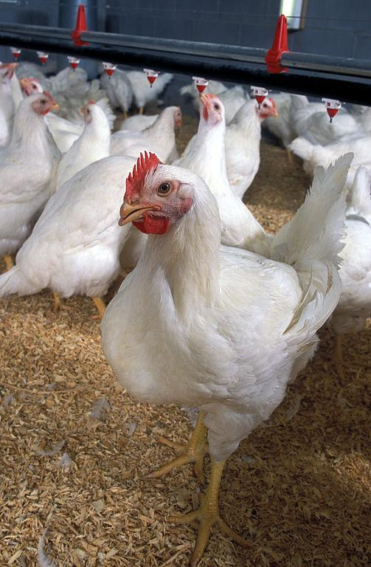
NISD Broiler Show Team
Advisor: Ms. Smith- emily.smith@nisdtx.org

Slide 2
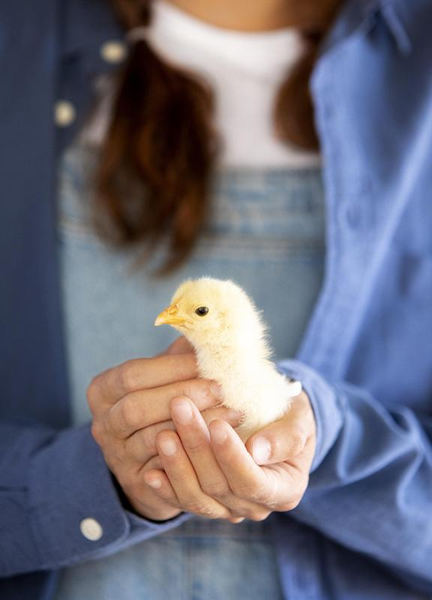
What are you showing?
You will get 25 day old Cornish Cross chickens and show your best 3 males and best 3 females at 7-8 weeks old.

Slide 3
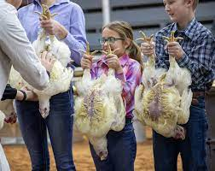
How to show
You & 2 friends will hold your 3 birds in front of you while the judge examines the birds.
The birds will weigh 5-9 lbs each at this time.

Slide 4
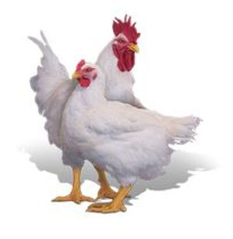
What are we looking for?
Uniformity among 3 birds
Same sex
Similar weight
Heavy Muscling
Fat deposits on the breasts
Long breastbone parallel to the backbone
Long wide back
Dark yellow- orange skin pigment

Slide 5
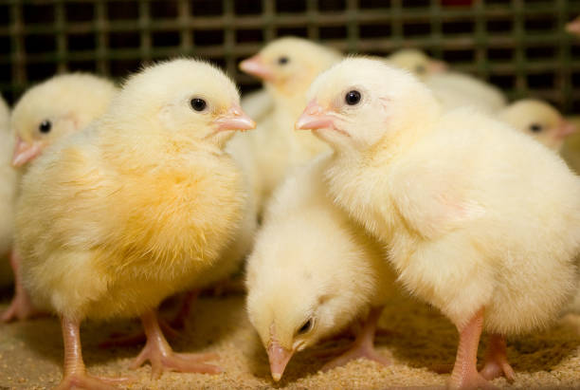
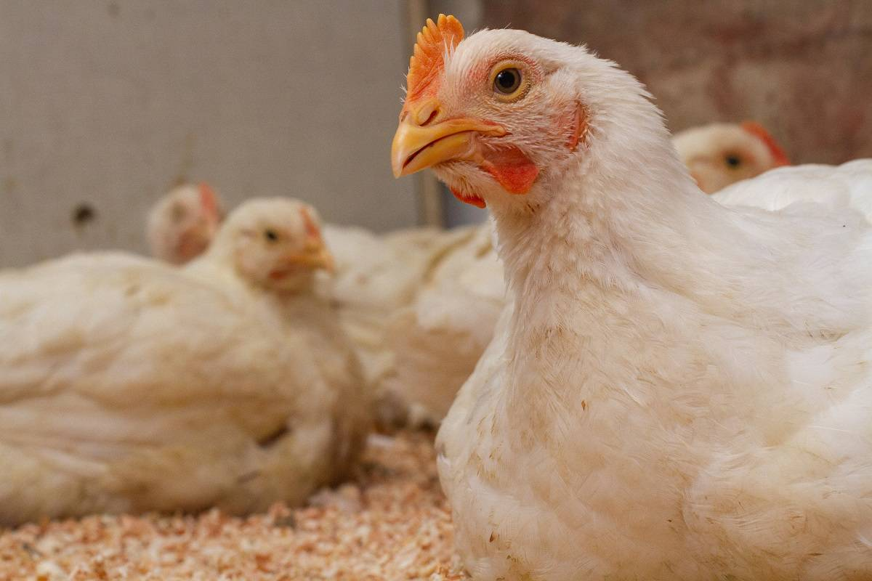
Poultry Timeline
01
02
03
04
Order
Receive
Culling
Show
Place orders in December.
Receive broilers around February 10th.
Begin culling birds at 3-4 weeks old.
Denton County Show
March 26-April 1
Notes:
I will come check the birds starting at 3 weeks old to begin culling and will come back once a week until show.

Slide 6
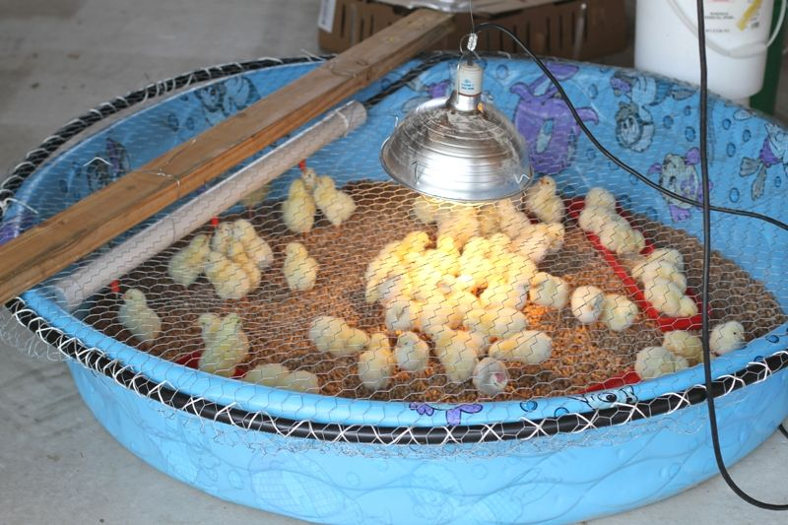
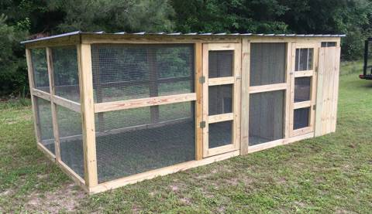
Facilities
First 2 Weeks
3-4 Weeks +
Hard plastic kid pool
Heat source until all feathers come in
Ventilation
Multiple feed pans
Multiple small waterers
50-100 square foot coop
No roosts in the coop
Secure from predators
Fans
High Ventilation
Multiple large feeders
Multiple large waterers

Slide 7
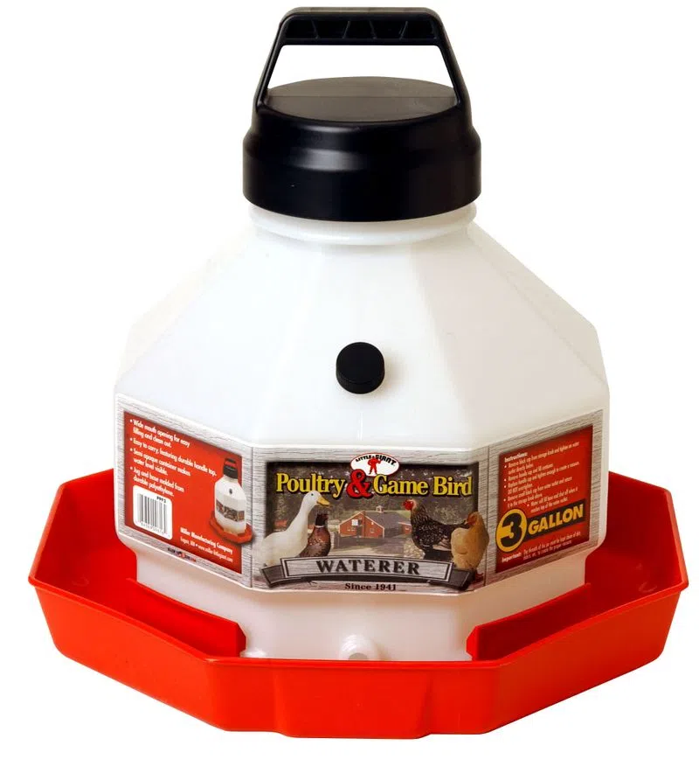
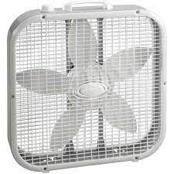
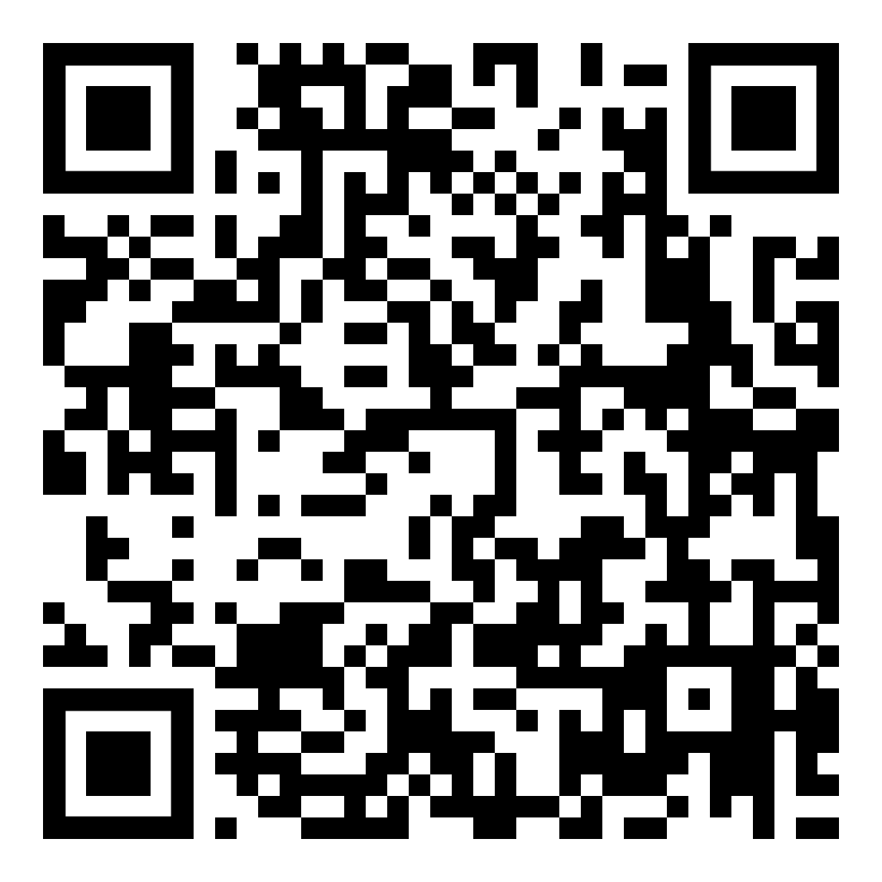
Supplies
Non-Optional Supplies:
Heat Lamps/Source
Fan(s)
Thermometer
Small Feed Trays
Large Feed Containers
Waterers
Marbles
Pine Shavings
Ms. Smith will order these in advance for students:
Pen of 25 chickens
Feed
Optional Supplies:
Supplements
Radio or a Rabbit
QR Code to Amazon Supply List
You can purchase supplies on Amazon.com, NRS, Russell Feed Supply, & Tractor Supply

Slide 8
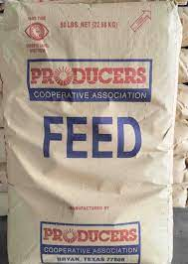
Feed
Producer’s Co-Op:
1 bag of Turkey Starter Crumble
1 bag of Turkey Starter Pellet
1 bag of Show Broiler Starter Pellet
4 bags of Show Broiler Finisher Pellet
Optional Supplements:
Citra-lite $15.95
Quick Start $48.95
R&D Top 2™ Broiler & Turkey Supplement
15 lbs. Bucket - $55.00
25 lbs. Bucket - $90.00
Power Fuel $49.99 (share w/ someone)
Champion Drive $52.99 (share w/ someone)

Slide 9
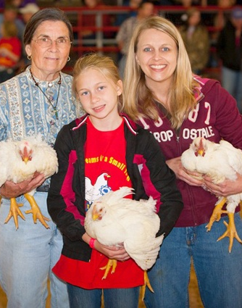
Rough Cost Estimate
General Costs:
Pen of 25 birds= $45
Feed= $140
Entries= $50
Supplements= $0-$220
Supplies= $0-$250
Total Estimate= $235-$705
>
Depends on how much you want to get/ already have
This does not include the cost to build or rent facilities

Slide 10
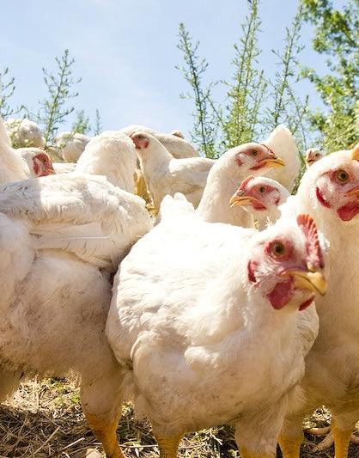
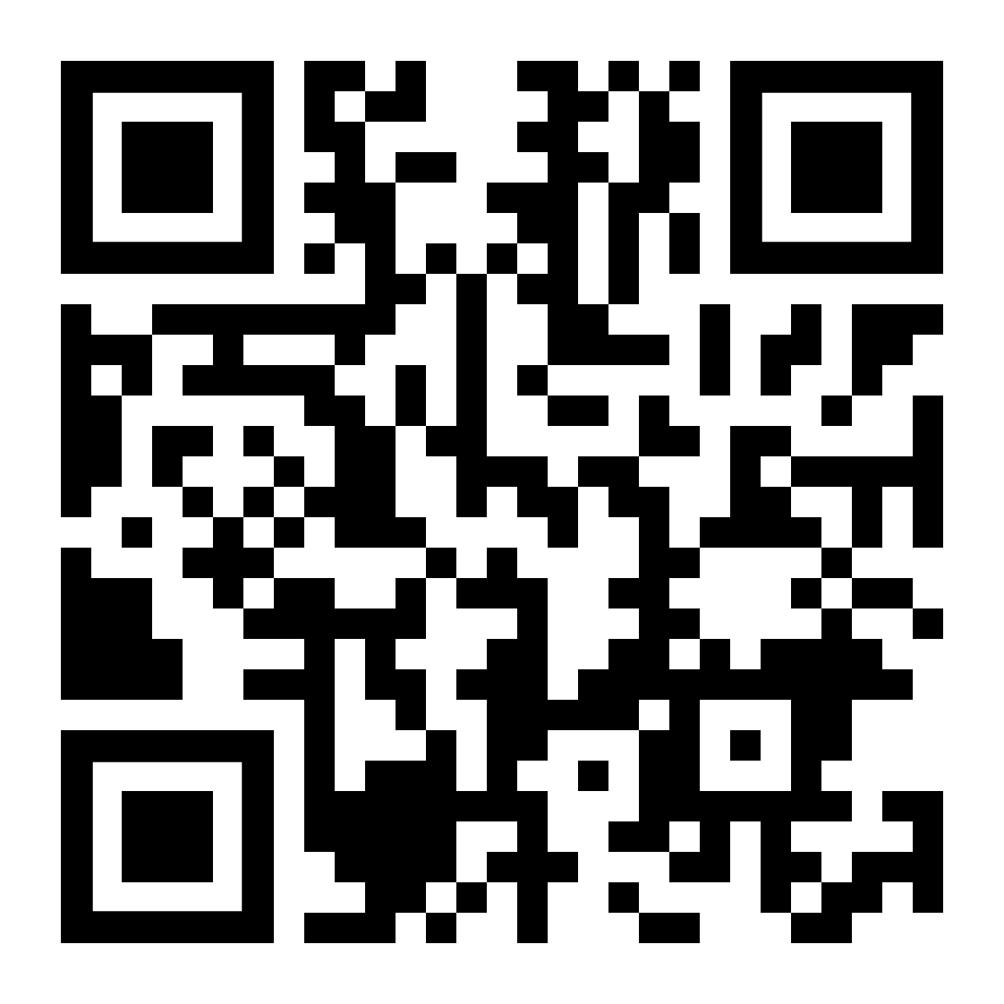
Communication
Remind:
https://www.remind.com/join/df43h8
Advisor Contact Info:
Emily Smith
Northwest High School
Email: emily.smith@nisdtx.org

